Slide 1
Artificial Intelligence
Ref: Deepak Khemani, IIT,Madras.

Slide 2
Syllabus
Introduction: AI , Agents, Structure of agents, Architecture.
Search Algorithms: Uninformed search, Breadth-first search, Depth-first search,Greedy best first search,minmax algorithm, Alpha-beta pruning.
Logic and Inferences: propositional Logic, First order logic
Classical Planning: State space search.
Knowledge representation: Acting under uncertainty,Baye’s rule and its use.

Slide 3
Text Book and References
Stuart Russel,Peter Norvig. Artificial Intelligence A Modern approach.
Deepak Khemani. A first course on Artificial Intelligence.
Elaine Rich Kevin Knight: Artificial Intelligence

Slide 4
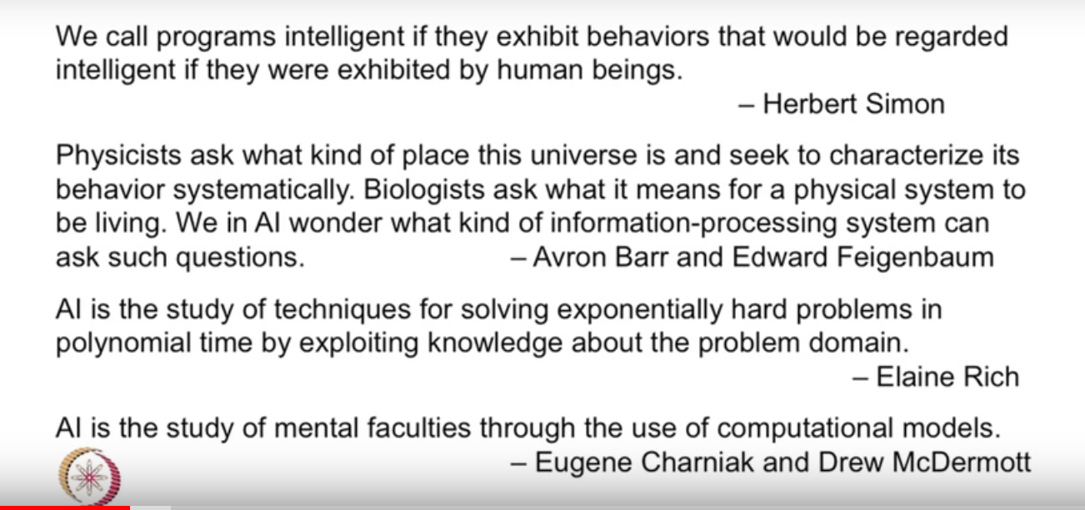

Slide 5
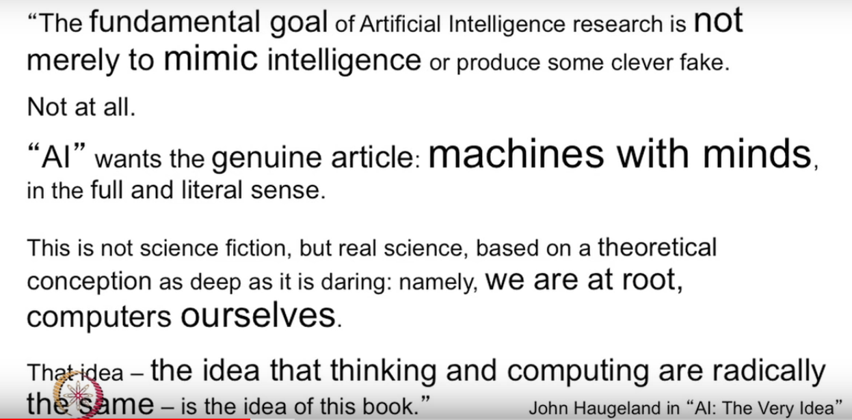

Slide 6
What is Intelligence??
What is thinking??
What is the Machine?
Is the computer a machine?
Can a machine think?

Slide 7
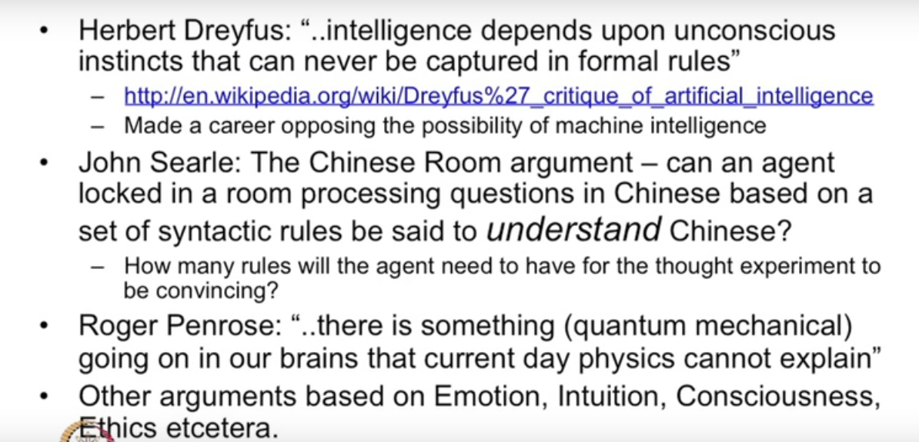

Slide 8
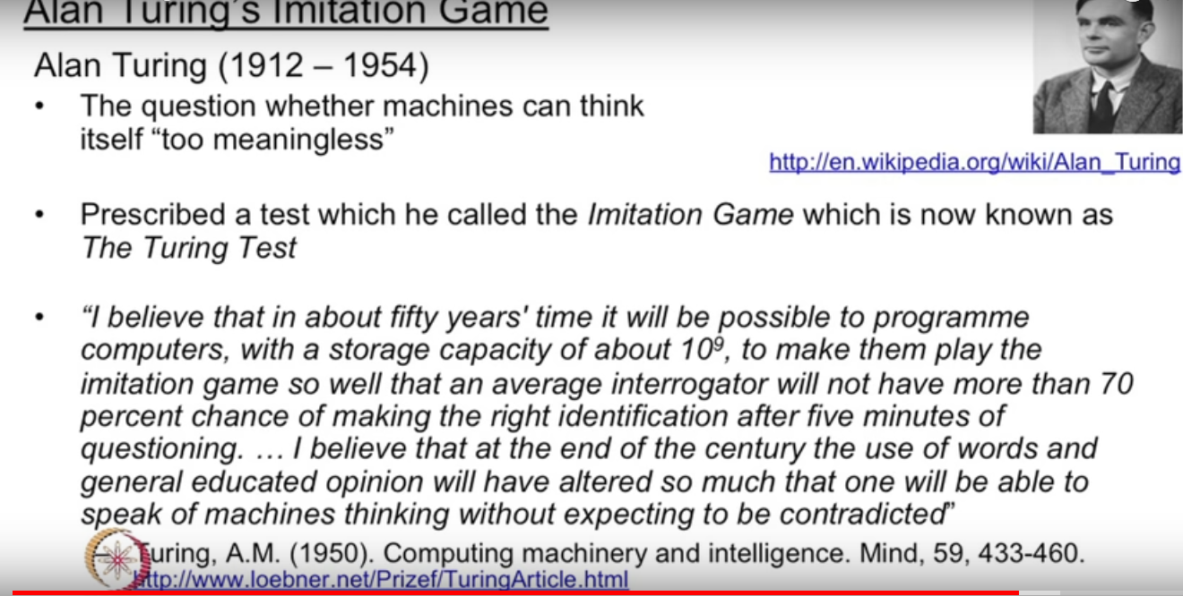

Slide 9
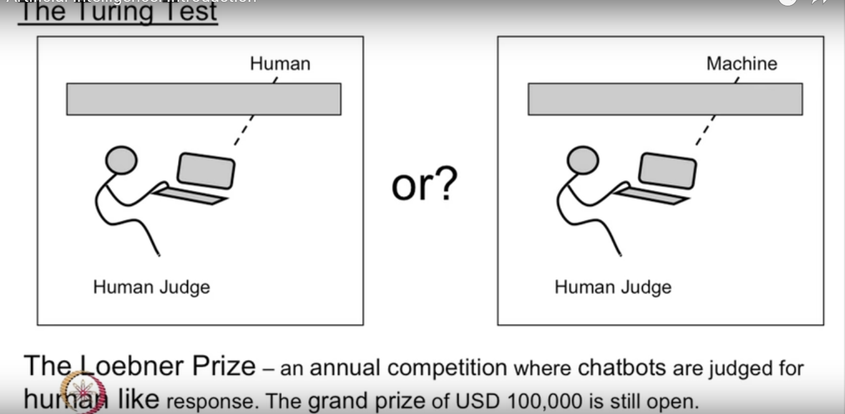

Slide 10
Points discussed in the last class
Components of AI
Approaches to AI
Chinese Room Test
Turing Test

Slide 11
Objective of today’s class( 28/03/2022)
Define an agent
Define an Intelligent agent
Define a Rational agent
Explain bounded rationality
Different types of environment
Different agent architecture

Slide 12
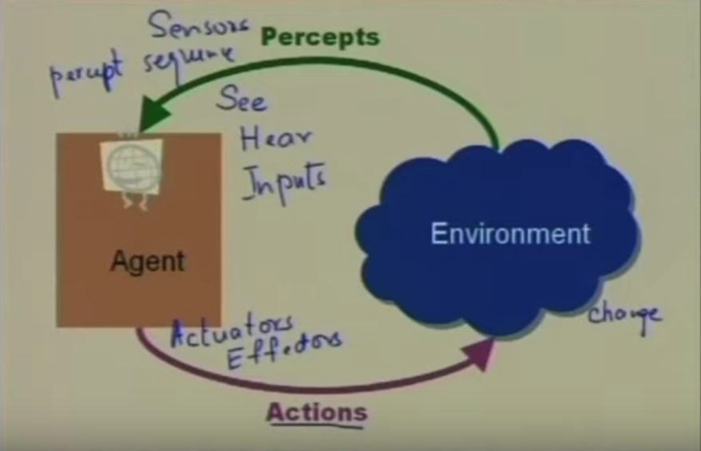
Agent and Environment

Slide 13
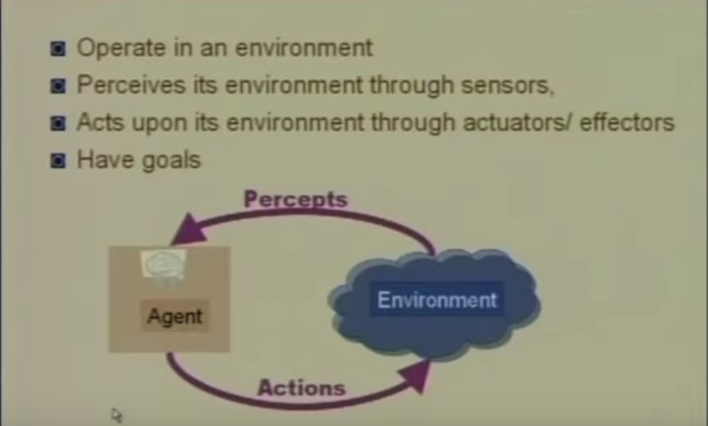
Agents

Slide 14
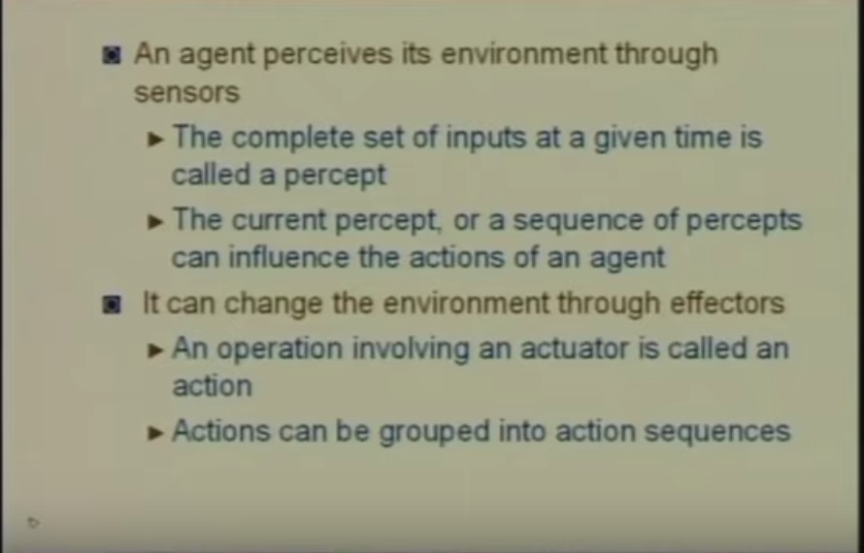
Sensors and Actuators

Slide 15
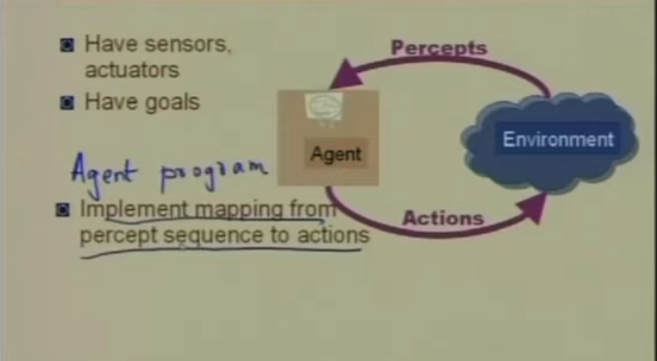
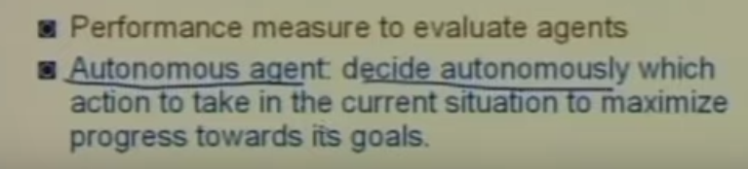
Agents

Slide 16
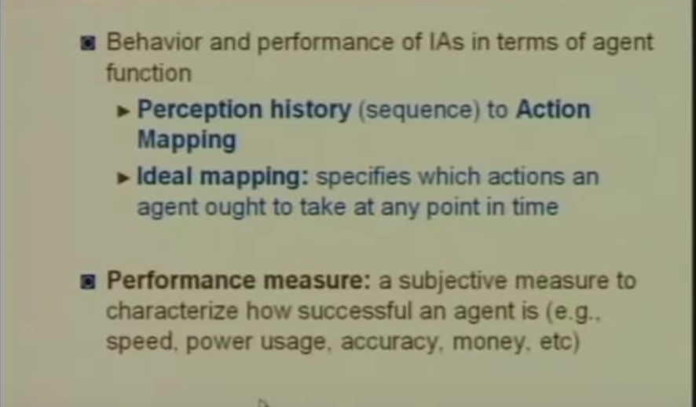
Performance

Slide 17
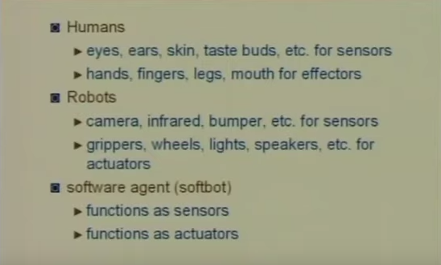
Example of agents

Slide 18
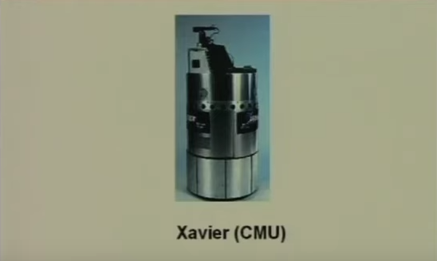
Types of agents

Slide 19
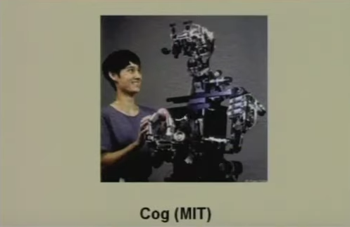
Types of Agents

Slide 20
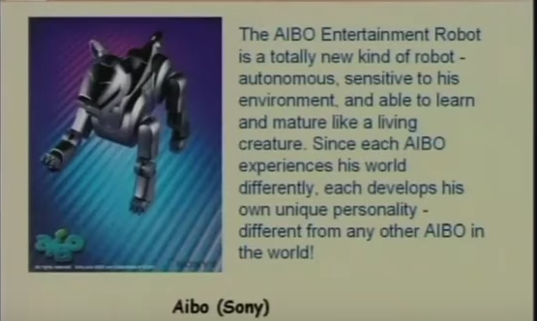

Slide 21
Types of Agents
Softbots
Expert Systems- Cardiologists
Autonomous space craft- Mars Rover
Intelligent Building.

Slide 22
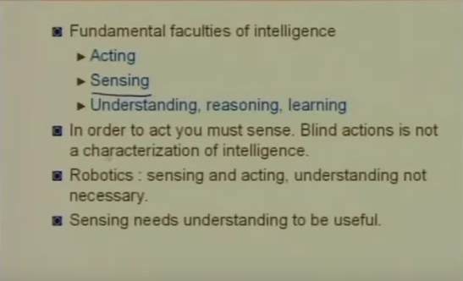
Agents

Slide 23
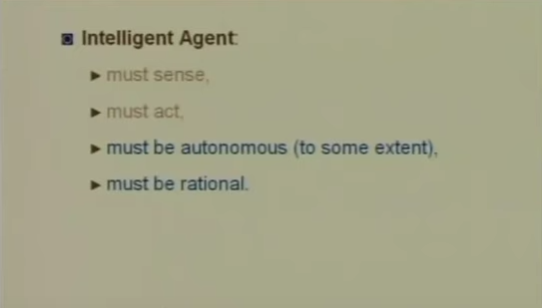
Intelligent Agent

Slide 24
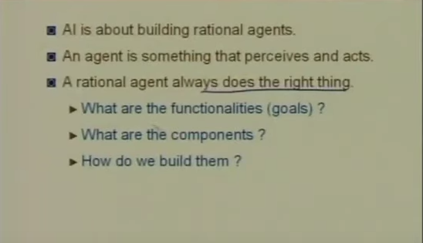
Rational Agent

Slide 25
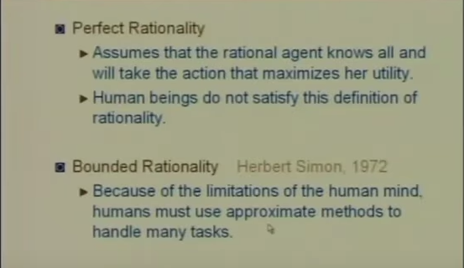
Rationality

Slide 26
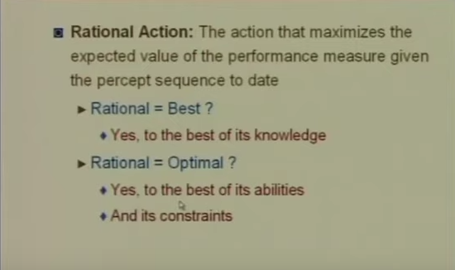
Rationality

Slide 27
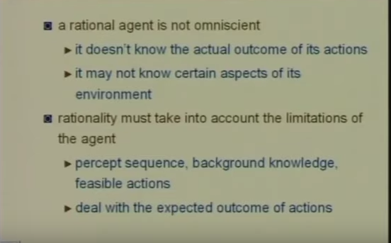
Omniscience
Omniscience is the state of possessing unlimited knowledge about all things possible. The religious aspects suggest omniscience is an attribute of God

Slide 28
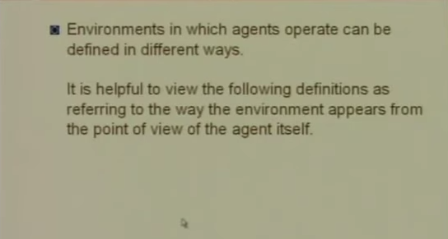
Agent Environment

Slide 29
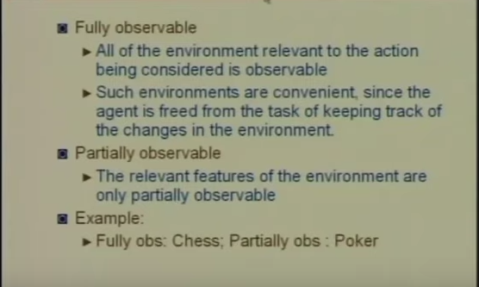
Environment: Obsevability

Slide 30
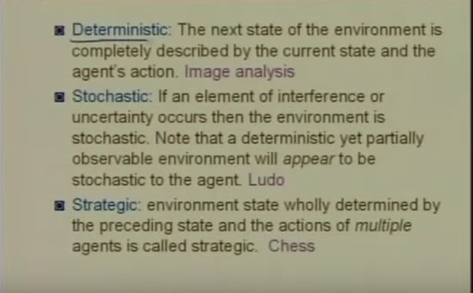
Environment:Determinism

Slide 31
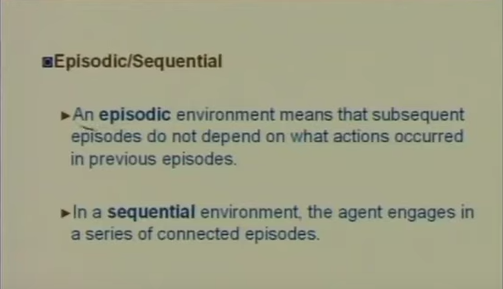

Slide 32
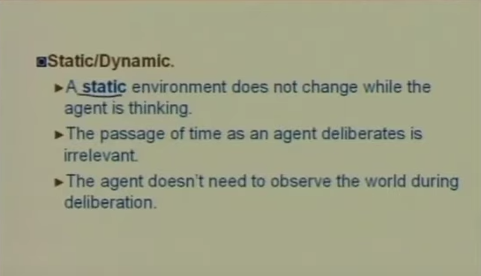
Environment

Slide 33
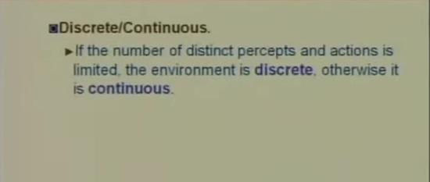
Environment:Continuity
Discrete = time moves in fixed steps, usually with one measurement per step (and perhaps one action, but could be no action). E.g. a game of chess
Continuous = Signals constantly coming into sensors, actions continually changing. E.g. driving a car

Slide 34
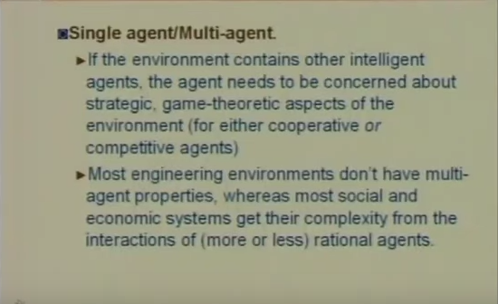
Environments: Other Agents

Slide 35
Types of Agents
Simple Reflex Agents
Model-Based Reflex Agents
Goal-Based Agents
Utility-Based Agents
Learning Agent

Slide 36
Simple reflex agents
act only on the basis of the current percept.
The agent function is based on the condition-action rule. A condition-action rule is a rule that maps a state i.e, condition to an action.
If the condition is true, then the action is taken, else not
This agent function only succeeds when the environment is fully observable.

Slide 37
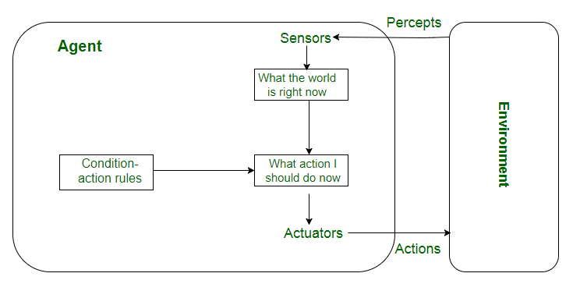
Simple reflex agents

Slide 38
Model-based reflex agents
A model-based agent can handle partially observable environments.
The agent has to keep track of the internal state which is adjusted by each percept and that depends on the percept history.

Slide 39
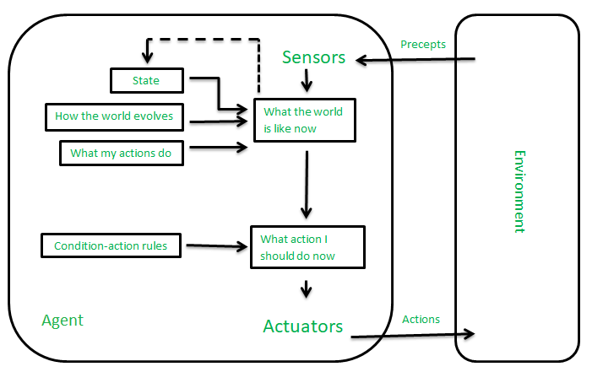
Model-based reflex agents

Slide 40
Goal-based agents
These kinds of agents take decisions based on how far they are currently from their goal.
Their every action is intended to reduce its distance from the goal.
This allows the agent a way to choose among multiple possibilities, selecting the one which reaches a goal state.

Slide 41
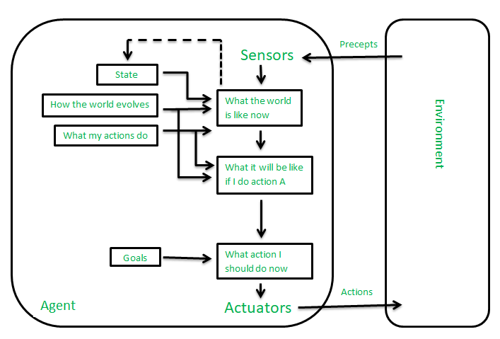
Goal-based agents

Slide 42
Utility-based agents
When there are multiple possible alternatives, then to decide which one is best, utility-based agents are used..
They choose actions based on a preference (utility) for each state.
Sometimes achieving the desired goal is not enough. We may look for a quicker, safer, cheaper trip to reach a destination.
Agent happiness should be taken into consideration.
Utility describes how “happy” the agent is. Because of the uncertainty in the world, a utility agent chooses the action that maximizes the expected utility.

Slide 43
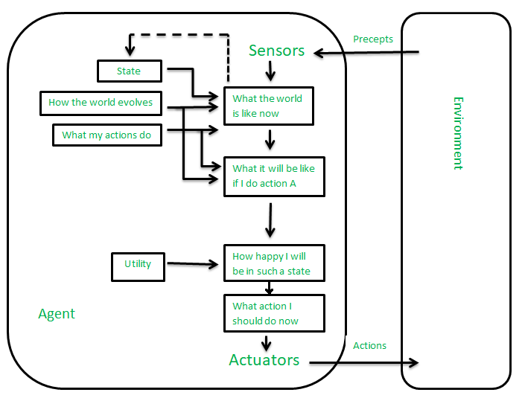
Utility-based agents

Slide 44
Learning Agent :
A learning agent in AI is the type of agent that can learn from its past experiences or it has learning capabilities. It starts to act with basic knowledge and then is able to act and adapt automatically through learning. A learning agent has mainly four conceptual components, which are:
Learning element: It is responsible for making improvements by learning from the environment
Critic: The learning element takes feedback from critics which describes how well the agent is doing with respect to a fixed performance standard.
Performance element: It is responsible for selecting external action
Problem Generator: This component is responsible for suggesting actions that will lead to new and informative experiences.

Slide 45
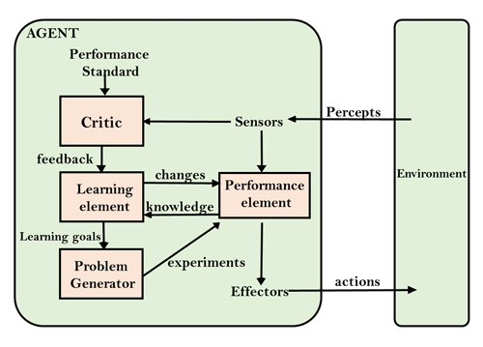

Slide 46
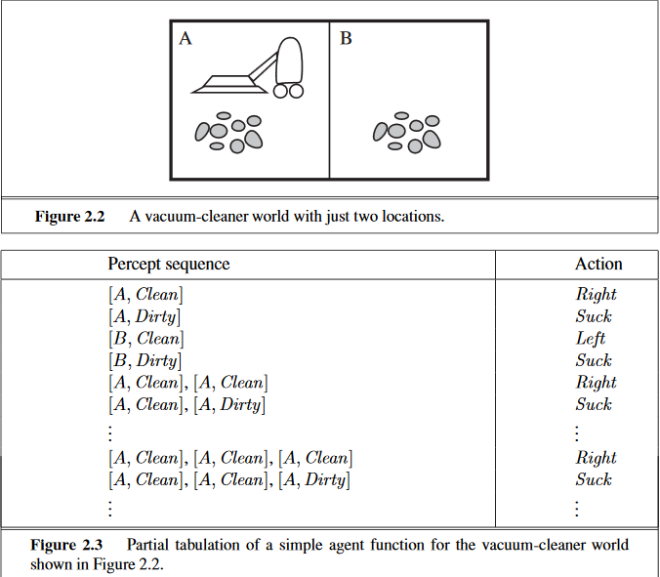

Slide 47
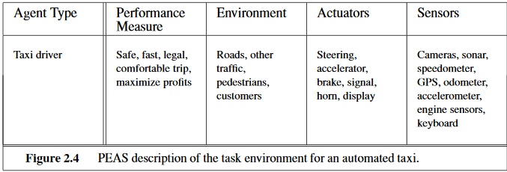

Slide 48
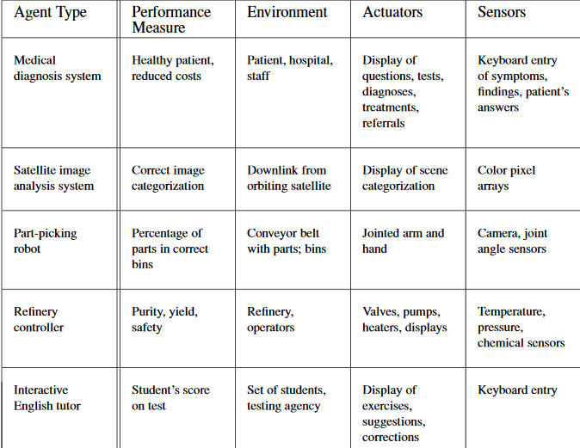

Slide 49
PEAS description of the “online shopping agent”
Performance measures:
Price of the book
Author of the book
Quality of the book
Book reviews on google.
Obtain interested/desired books.
Cost minimisation

Slide 50
Environment:
Internet websites.
Web pages of particular website
Vendors/Sellers
Shippers
Actuators:
Filling the forms.
Display to the user
Follow url
Sensors:
Keyboard entry
Browser used to find web pages
HTML

Slide 51
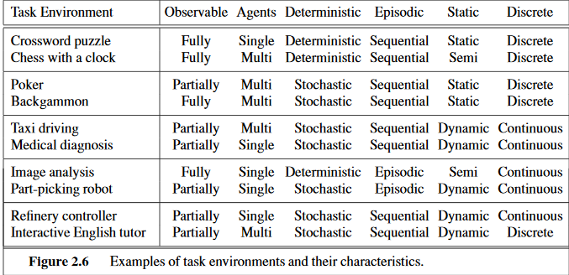

Slide 52
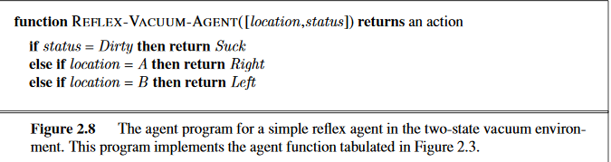

Slide 53
Rational Agent
A rational agent is an agent which has clear preference, models uncertainty, and acts in a way to maximize its performance measure with all possible actions.
A rational agent is said to perform the right things. AI is about creating rational agents to use for game theory and decision theory for various real-world scenarios

Slide 54
Agent Program and Agent function
The job of AI is to design an agent program that implements the agent function.
The agent function, notionally speaking, takes as input the entire percept sequence up to that point, whereas the agent program takes the current percept only.
When a agent function is implemented then, by which it gets implemented is known as agent program

